Slide 1
Data Link Layer
Data Link Layer is generally representing protocol layer in program that is simply used to handle and control the transmission of data between source and destination machines. It is simply responsible for exchange of frames among nodes or machines over physical network media.

Slide 2
Functionality of Data-link Layer
Data link layer does many tasks on behalf of upper layer. These are:
Framing
Data-link layer takes packets from Network Layer and encapsulates them into Frames. Then, it sends each frame bit-by-bit on the hardware. At receiver’ end, data link layer picks up signals from hardware and assembles them into frames.
Addressing
Data-link layer provides layer-2 hardware addressing mechanism. Hardware address is assumed to be unique on the link. It is encoded into hardware at the time of manufacturing.
Synchronization
When data frames are sent on the link, both machines must be synchronized in order to transfer to take place.

Slide 3
Error Control
Sometimes signals may have encountered problem in transition and the bits are flipped. These errors are detected and attempted to recover actual data bits. It also provides error reporting mechanism to the sender.
Flow Control
Stations on same link may have different speed or capacity. Data-link layer ensures flow control that enables both machine to exchange data on same speed.

Slide 4
Types of Services provided by Data Link Layer :
The Data link layer generally provides or offers three types of services as given below :
Unacknowledged Connectionless Service
2. Acknowledged Connectionless Service
3. Acknowledged Connection-Oriented Service
1. Unacknowledged Connectionless Service :
Unacknowledged connectionless service simply provides datagram styles delivery without any error, issue, or flow control. In this service, source machine generally transmits independent frames to destination machine without having destination machine to acknowledge these frames.
This service is called as connectionless service because there is no connection established among sending or source machine and destination or receiving machine before data transfer or release after data transfer.

Slide 5
Acknowledged Connectionless Service : This service simply provides acknowledged connectionless service i.e. packet delivery is simply acknowledged, with help of stop and wait for protocol.
In this service, each frame that is transmitted by Data Link Layer is simply acknowledged individually and then sender usually knows whether or not these transmitted data frames received safely. There is no logical connection established and each frame that is transmitted is acknowledged individually.
This service is more reliable than unacknowledged connectionless service. This service is generally useful over several unreliable channels, like wireless systems, Wi-Fi services, etc.
Acknowledged Connection-Oriented Service : In this type of service, connection is established first among sender and receiver or source and destination before data is transferred.
Then data is transferred or transmitted along with this established connection. In this service, each of frames that are transmitted is provided individual numbers first, so as to confirm and guarantee that each of frames is received only once that too in an appropriate order and sequence.

Slide 6
MAC Address
MAC address is the physical address, which uniquely identifies each device on a given network. To make communication between two networked devices, we need two addresses: IP address and MAC address. It is assigned to the NIC (Network Interface card) of each device that can be connected to the internet.
It stands for Media Access Control, and also known as Physical address, hardware address.
It is globally unique; it means two devices cannot have the same MAC address. It is represented in a hexadecimal format on each device, such as 00:0a:95:9d:67:16.
It is 12-digit, and 48 bits long, out of which the first 24 bits are used for OUI(Organization Unique Identifier), and 24 bits are for NIC/vendor-specific.
It works on the data link layer of the OSI model.
It is provided by the device's vendor at the time of manufacturing and embedded in its NIC, which is ideally cannot be changed.
The ARP protocol is used to associate a logical address with a physical or MAC address.

Slide 7
Format of MAC address
It is 12 digits or 6-byte hexadecimal number, which is represented in colon-hexadecimal notation format. It is divided into six octets, and each octet contains 8 bits.
The first three octets are used as the OUI or Organizationally Unique Identifier. These MAC prefixes are assigned to each organization or vendor by the IEEE Registration Authority Committee.
The last three octets are NIC specific and used by the manufacturer to each NIC card. Vendors or manufacturers can use any sequence of digits to the NIC specific digits, but the prefix should be the same as provided by the IEEE.

Slide 8
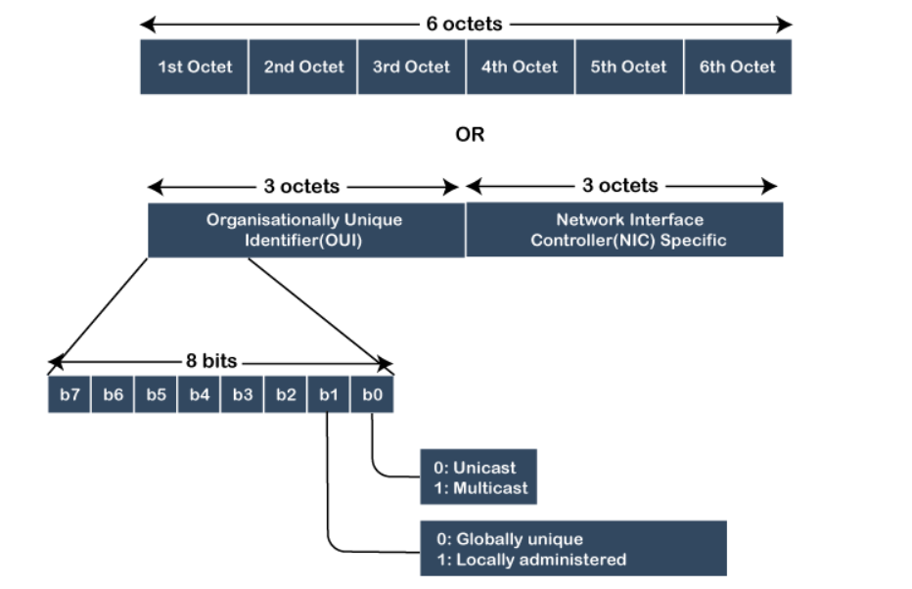

Slide 9
Stop and Wait Protocol-
It is the simplest flow control method. In this, the sender will transmit one frame at a time to the receiver. The sender will stop and wait for the acknowledgement from the receiver.
This time (i.e. the time joining message transmitting and acknowledgement receiving) is the sender’s waiting time, and the sender is idle during this time.
When the sender gets the acknowledgement (ACK), it will send the next data packet to the receiver and wait for the disclosure again, and this process will continue as long as the sender has the data to send.
While sending the data from the sender to the receiver, the data flow needs to be controlled. If the sender is transmitting the data at a rate higher than the receiver can receive and process it, the data will get lost.

Slide 10
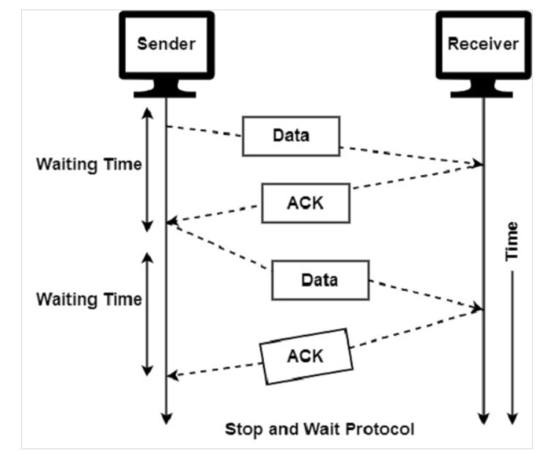

Slide 11
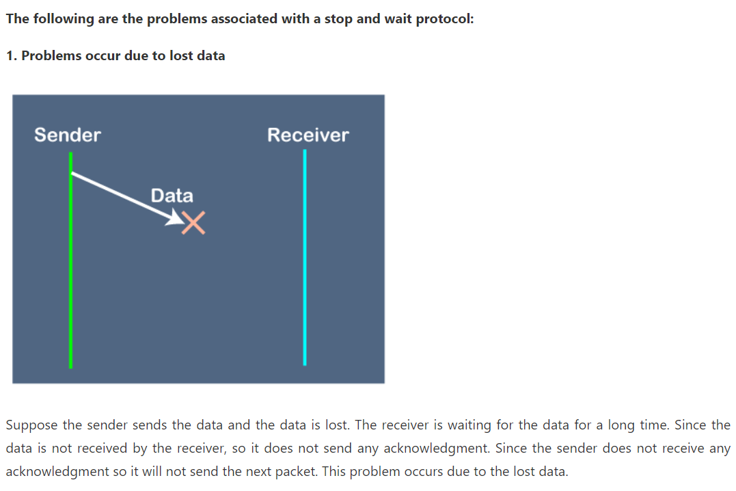

Slide 12
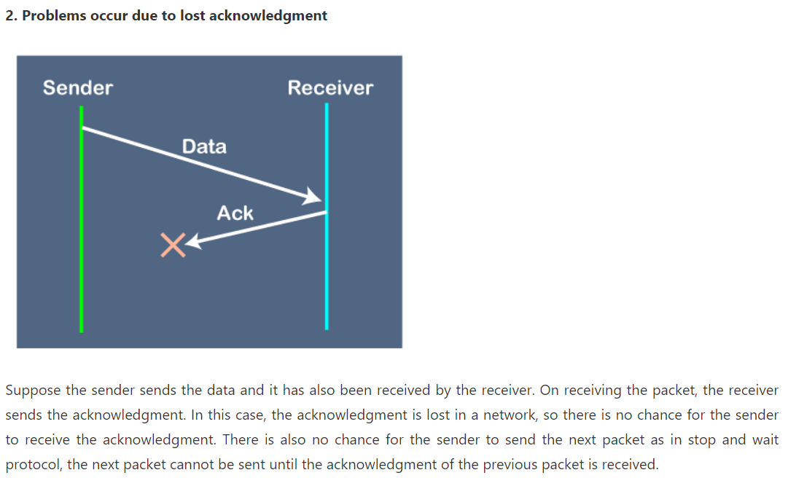

Slide 13
